Slide 1
Polibot: Policy Search Assistant

Slide 2
Problem Statement
Currently, users may struggle to find specific answers in lengthy policy documents, requiring them to manually search or navigate through multiple sections. This is time-consuming.

Slide 3
Goals
AI-powered document search and Q&A system that enables users to directly ask questions and get precise answers with references from the document.
Personas benefiting from the Solution
Board Admins
Board Members
Staff
Public Users

Slide 4
Approach:
Convert policy documents into vector embeddings and store them in Milvus (or another vector DB).
Use an LLM model (Hugging Face/Mistral/Gemini) to retrieve relevant sections via similarity search.
Generate a structured response with references to the original document section.

Slide 5
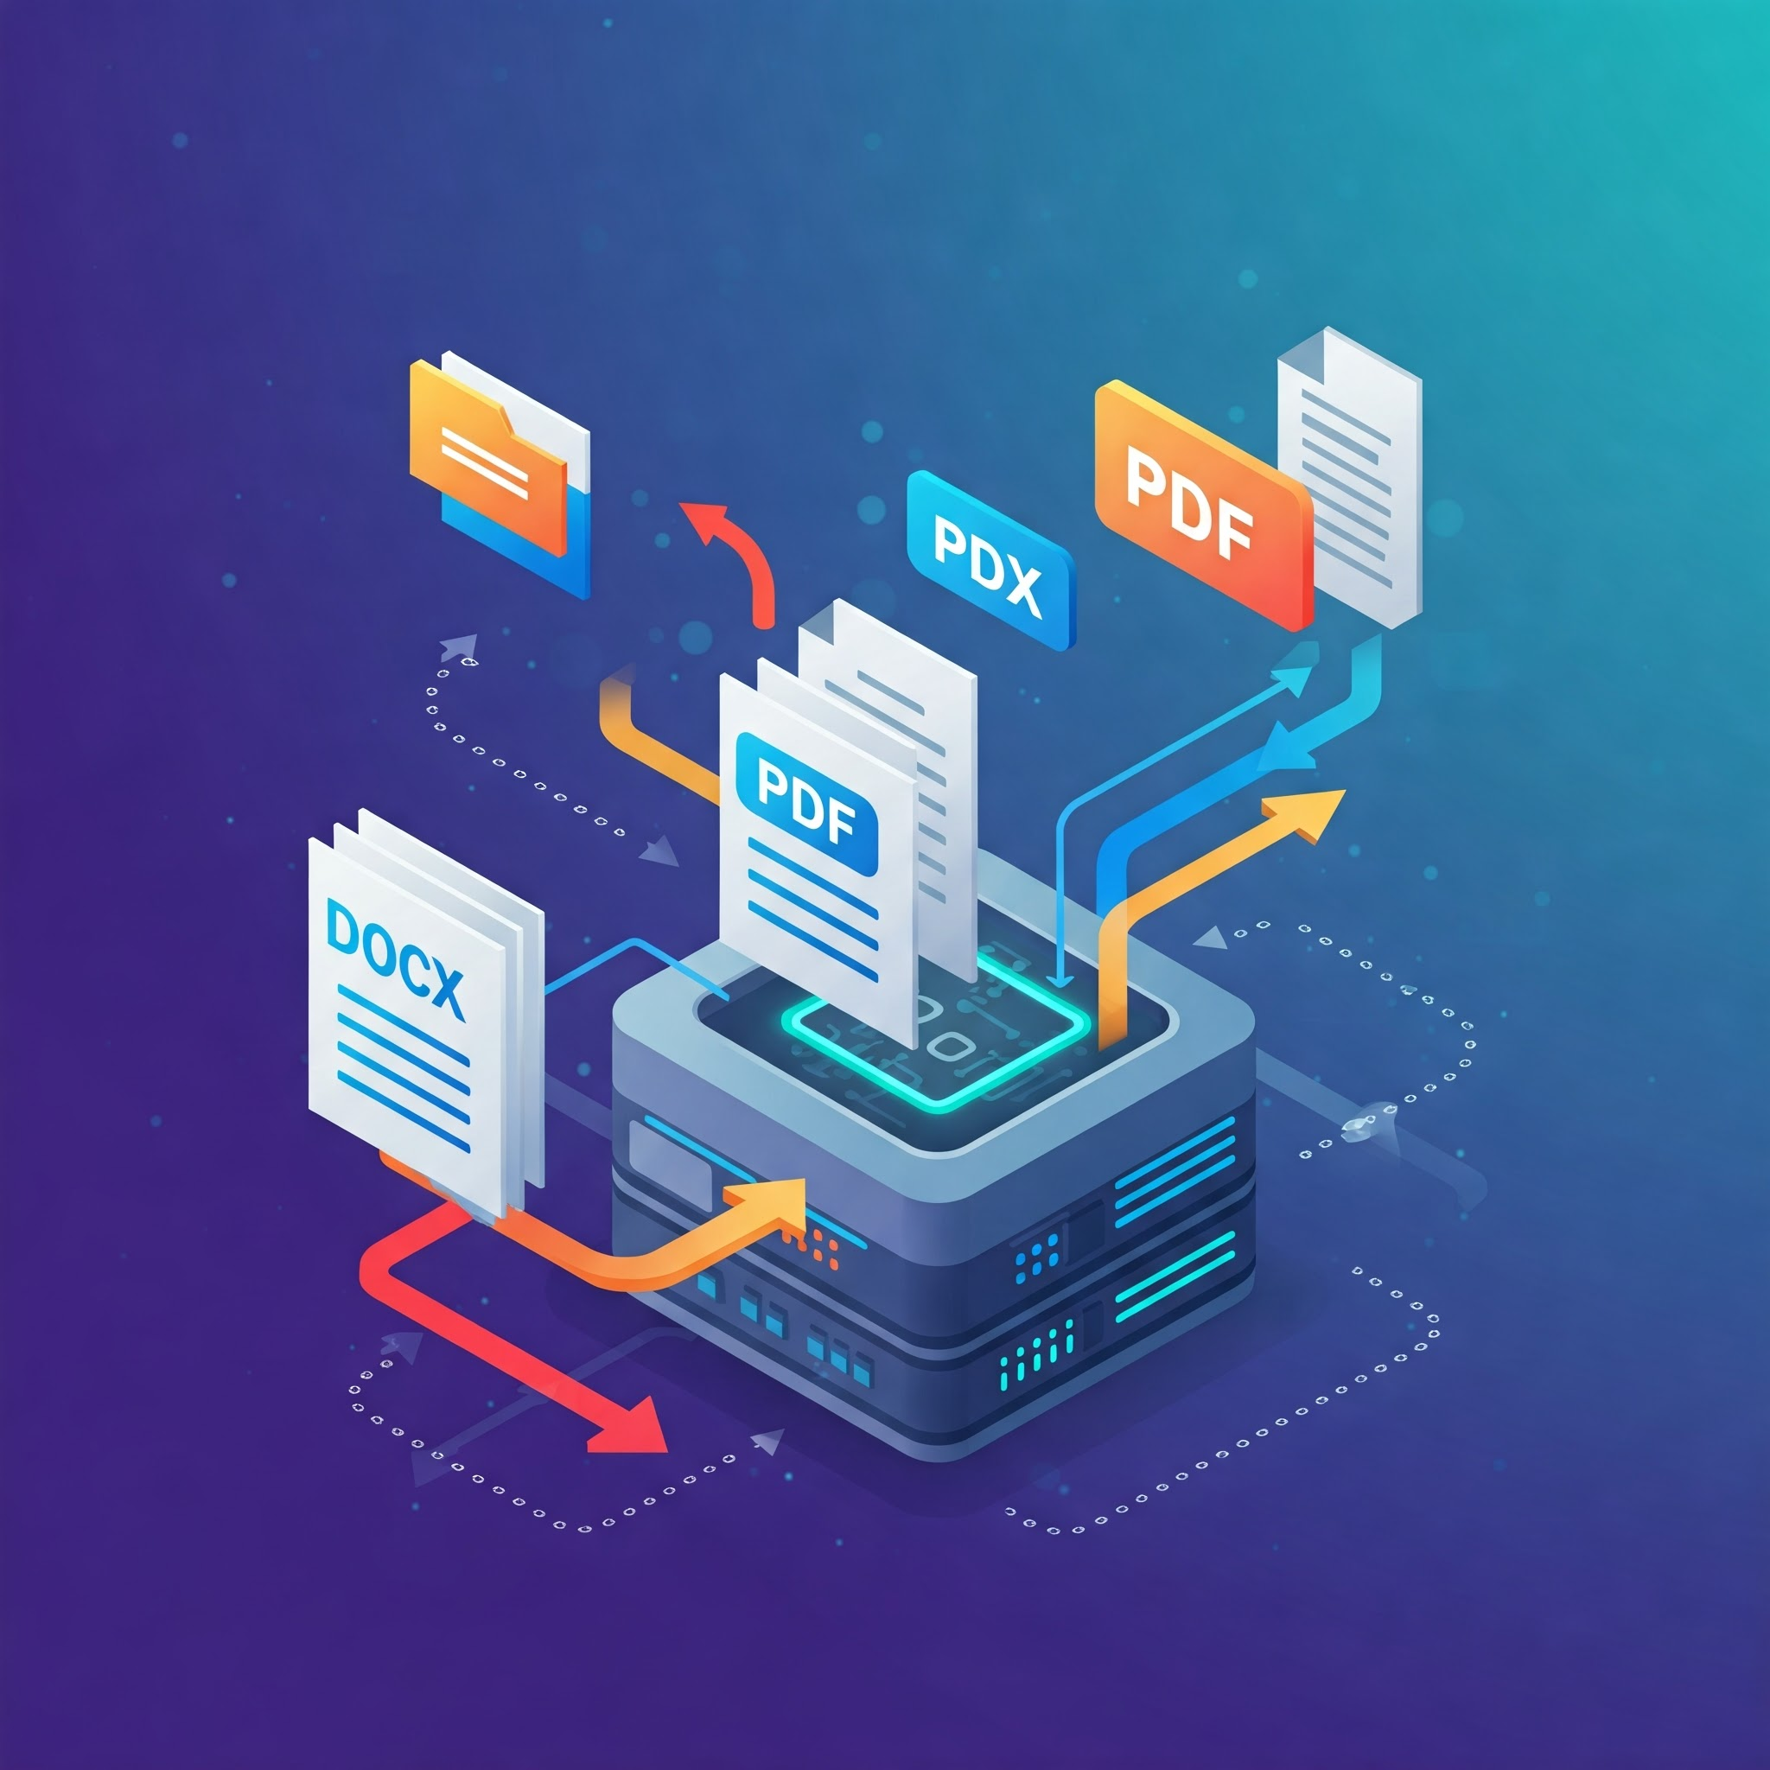






Documents Loading
Chunking
Embeddings Generation
Store in Vector DB (Milvus)
Answer with Privacy
LLM-based Answer Generation
Similarity Search

Slide 6
DEMO

Slide 7
PoliBot – Enhancements & Future Scope
Answer with Document Reference
Adds trust and transparency.
Helps board members verify info during meetings.
Document-Level Access Control
Public policies visible to all.
Private/internal policies only accessible to authorized users.
Multi-Document Referencing
Useful when policies are spread across files.

Slide 8
Thank you

